Slide 1
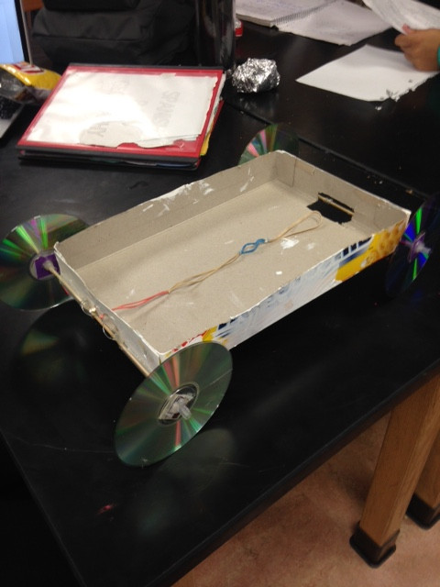
Cereal Box Car
By Julia CORBANI, CIARA SAMUEL, MADI JONES, AND COLIN MCCLOSKEY

Slide 2
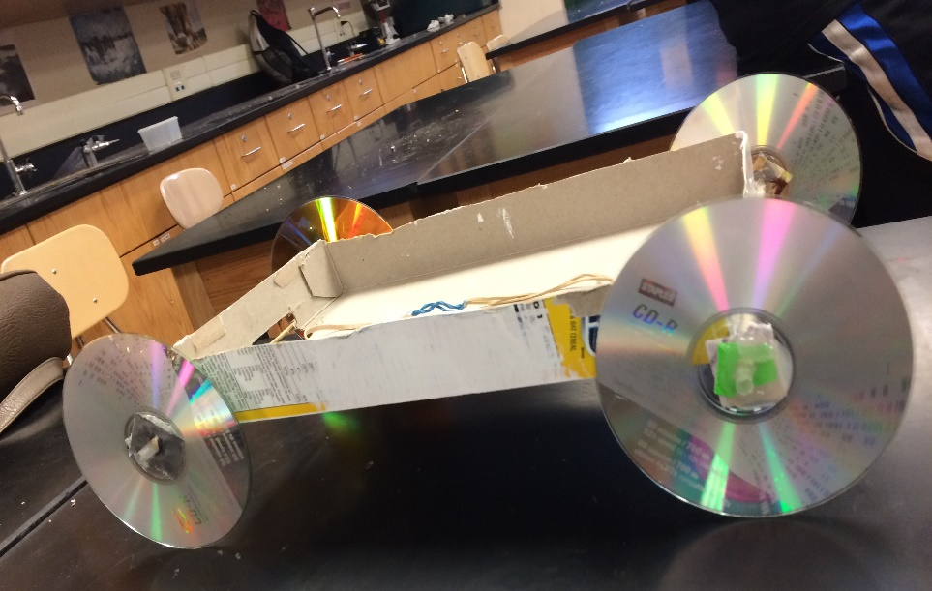
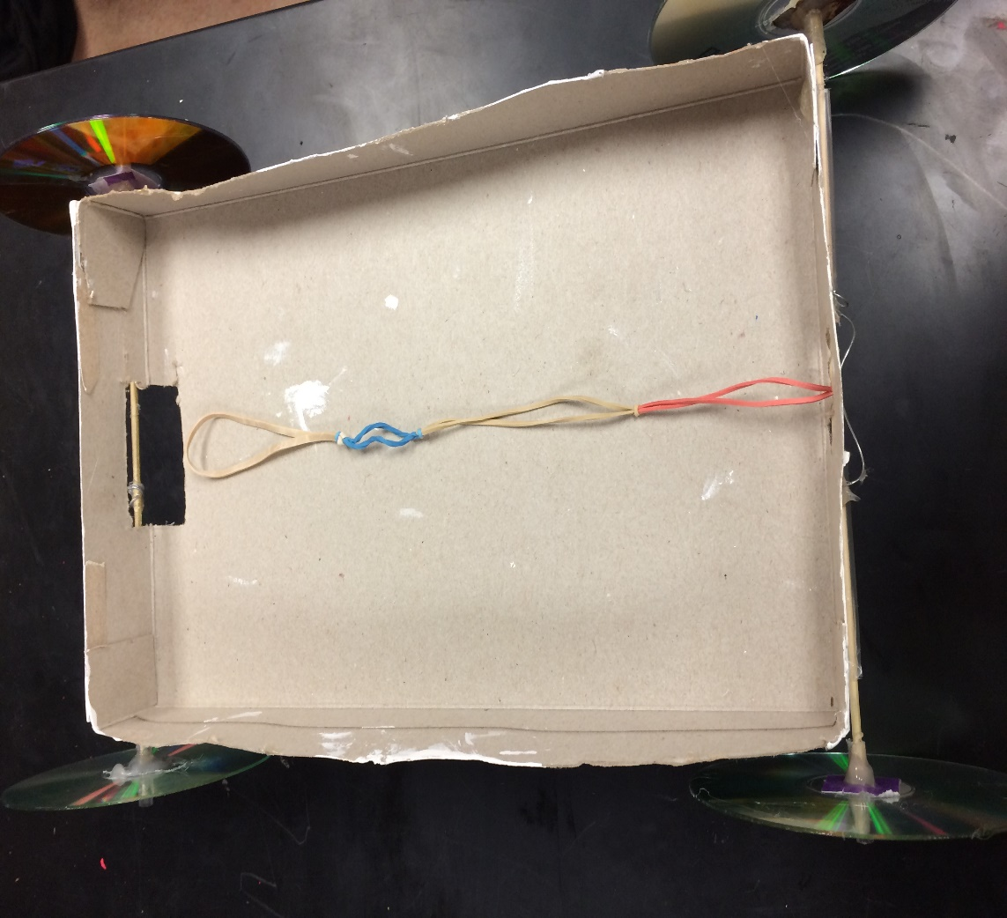
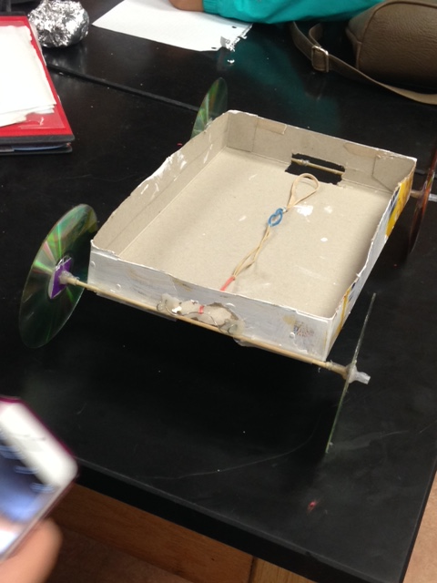
Here Are Some Pictures

Slide 3
NOW HERE IT GOES

Slide 4
Facts about Car
Our car with the 250 grams is .370 kilograms.
The elastic collision of our car is 5.944
The velocity it is going to get to each meter is:
0-1 meters | 1-2 meters | 2-3 meters | 3-4 meters | 4-5 meters
.092m/s | .305m/s | .525m/s | .362m/s | .105m/s

Slide 5
Efficiency and Cost
Our car is very fuel efficient because it only requires four rubber bands which can be reused over and over again. If you wish to go a longer distance, you can simply add more rubber bands.
At Target, you can buy 600 rubber bands for $1.69. This is very cost efficient as using all 600 would take you very far. A typical box of cereal costs about $3 to $5. You can buy a case of 50 CDs for about $10.

Slide 6
Style and Durability
This car can be any kind of box you want. It can be your favorite type of cereal or toy or you could even design yourself. The wheels can be your favorite movies or music. It can also be designed by yourself. It’s the hippest car on the road.
This car is decent when it comes to durability. The hot glue is able to hold it together and it can survive most crashes. However, it wouldn’t be able to survive major accidents.

Slide 7
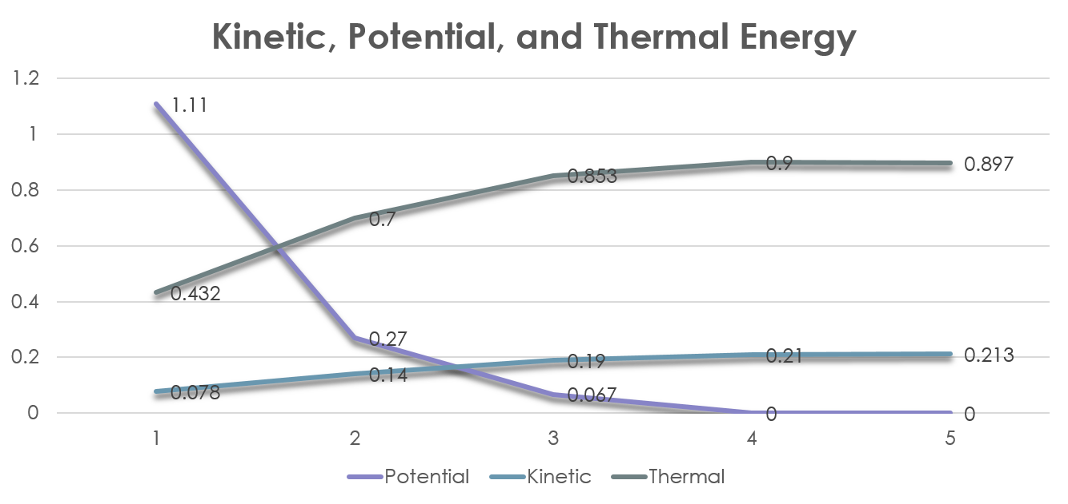
Energy Graph

Slide 8
Time vs Distance Graph

Slide 9
Velocity vs Time

